Slide 1

Predicting customer buying behaviour

Slide 2
Predictive modeling of customer bookings
ACCURACY
84%
PRECISSION
86%
RECALL
95%
Out of 50000 booking entries only 15.81% bookings were successfully or complete.
Percentage of round trips: 98.994 %
Percentage of One way trips: 0.774 %
Percentage of circle trips: 0.232 %
Number of bookings done through internet: 88.764 %
Number of bookings done through phone call: 11.236 %

Slide 3
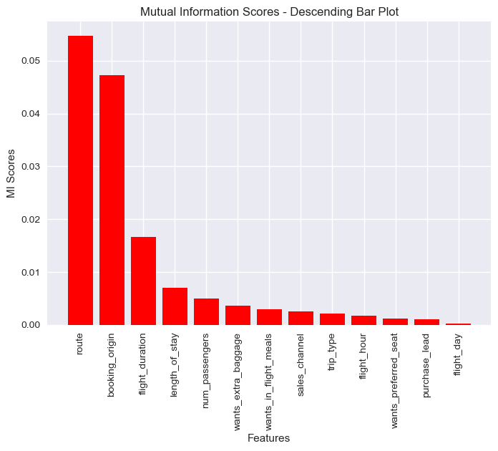
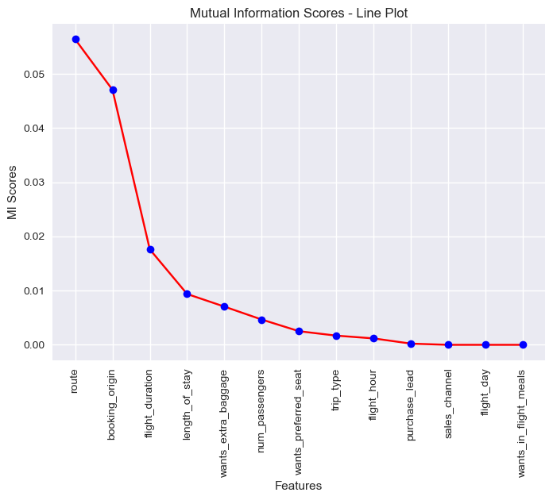
Percentage of Wants Preferred Seat: 0.0 : 70.812224 % , 1.0 : 29.187776 %
Percentage of Wants Extra Baggage: 1.0 :66.878% , 0.0 : 33.122 %
Important Features

Slide 4
model Accuracy ROC curve
Random forest classifier with top 6 features 84.224 0.559
Random forest classifier with all features 84.856 0.5531
confussion Matrix 84.856 0.5531
Model With GradientBoostingClassifier 84.792 0.54182
XGB classifier with top 6 features 84.848 0.52574
Model with XG Boost all features 84.848 0.52574
Model After HyperParameter tunning 85.368 0.5

Slide 5
If the focus is on overall classification accuracy, then we can compare the models based on the accuracy metric. In that case, the "Model after HyperParameter tuning" has the highest accuracy of 85.368%, making it the best model based on accuracy.
On the other hand, if the focus is on the model's ability to discriminate between positive and negative classes, the AUC score becomes more relevant. In this case, the "Random forest classifier with top 6 features" has the highest AUC score of 0.559, indicating better performance in distinguishing between classes.
Therefore, the choice of the better model depends on the specific evaluation criteria and priorities. If accuracy is more important, the "Model after HyperParameter tuning" is better. If AUC score is more important, the "Random forest classifier with top 6 features" is better.

